Slide 3
2-1 Sample Spaces and Events
2-1.1 Random Experiments
Figure 2-1 Continuous iteration between model and physical system.

Slide 4
2-1 Sample Spaces and Events
2-1.1 Random Experiments
Figure 2-2 Noise variables affect the transformation of inputs to outputs.

Slide 5
How do you quantify the influence of chance (randomness)? Randomness is not completely random!

Slide 6
2-1 Sample Spaces and Events
2-1.1 Random Experiments
Definition

Slide 7


2-1 Sample Spaces and Events
2-1.1 Random Experiments
Example

Slide 8
2-1 Sample Spaces and Events
2-1.2 Sample Spaces
Definition

Slide 9
2-1 Sample Spaces and Events
2-1.2 Sample Spaces
Example
a. Rolling a dice: S={1,2,3,4,5,6}
b. Betting: S={win, lose}
c. Guessing pin number S={000000,…,999999}

Slide 10
2-1 Sample Spaces and Events
Tree Diagrams
Sample spaces can also be described graphically with tree diagrams.
When a sample space can be constructed in several steps or stages, we can represent each of the n₁ ways of completing the first step as a branch of a tree.
Each of the ways of completing the second step can be represented as n₂ branches starting from the ends of the original branches, and so forth.

Slide 11
2-1 Sample Spaces and Events
2-1.3 Events
Definition

Slide 12
2-1 Sample Spaces and Events
2-1.3 Events
Example
a) Rolling a dice
E = getting even number = {2,4,6}
F = getting number at least 4 = {4,5,6}
b) Choose randomly 3 digits
E = one digit is sum of the other two
= {000, 011,…,990}

Slide 13
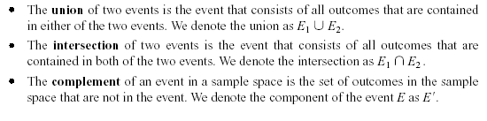
2-1 Sample Spaces and Events
2-1.3 Events
Basic Set Operations

Slide 14
2-1 Sample Spaces and Events
Definition

Slide 15
2-1 Sample Spaces and Events
Venn Diagrams
Figure 2-8 Venn diagrams.

Slide 16
2-2 Interpretations of Probability
2-2.1 Introduction
Probability
Used to quantify likelihood or chance
Used to represent risk or uncertainty in engineering applications
Can be interpreted as our degree of belief or relative frequency

Slide 17
2-2 Interpretations of Probability
Equally Likely Outcomes

Slide 18
2-2 Interpretations of Probability
Figure 2-11 Probability of the event E is the sum of the probabilities of the outcomes in E

Slide 19

2-2 Interpretations of Probability
Definition

Slide 20
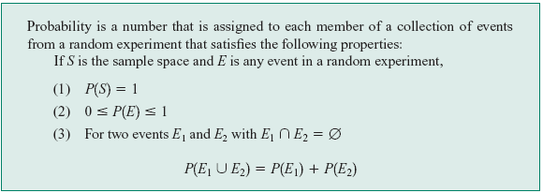
2-2 Interpretations of Probability
2-2.2 Axioms of Probability

Slide 21
2-3 Addition Rules
Probability of a Union

Slide 22
2-3 Addition Rules
Mutually Exclusive Events

Slide 23
2-3 Addition Rules
Three Events

Slide 24
2-3 Addition Rules

Slide 25
2-3 Addition Rules
Figure 2-12 Venn diagram of four mutually exclusive events

Slide 31
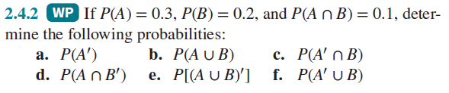

Slide 32
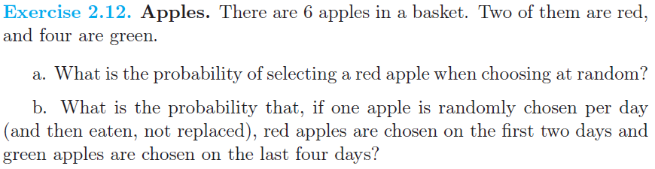

Slide 38
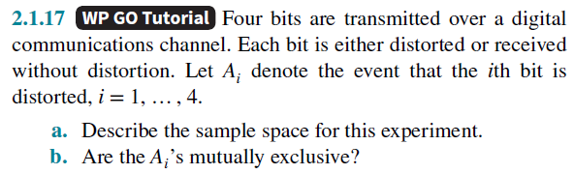

Slide 39
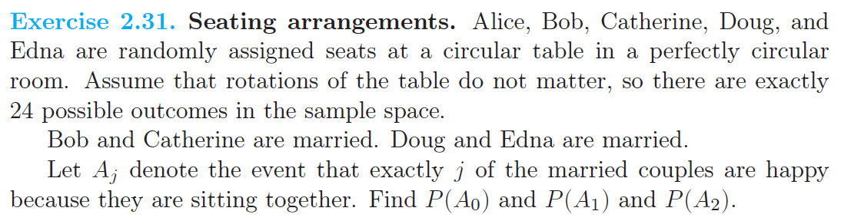

Slide 45

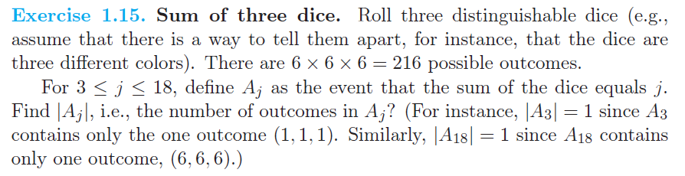

Slide 47
